Slide 1

Prompting Insight
Using Generative AI and Python to Visualize Library Data
Fantastic Futures 2025
December 3, 2025
British Library, London, UK

Slide 2


Your presenters
Eric Prosser
Jason Bronowitz
STEM Division Head
Engineering and Entrepreneurship Librarian
Associate Director for Academic Excellence, The Polytechnic School
Program Chair, AI Engineering (Human-Centered AI)

Slide 3
Workshop Overview

Slide 4
Overview
Introducing an AI-driven tool to develop coding skills
Intended for all levels of skills and experience
Key themes
Generative AI as a coding assistant
Unlocking unused data
Human-centered analytics

Slide 5
Learning Outcomes
Develop practical AI prompting skills
Experience data analysis through Python
Reflect on ethical frameworks for AI use

Slide 6
Agenda
Foundations
Prompting the model
Analysis in action
Interpretation and next steps

Slide 7
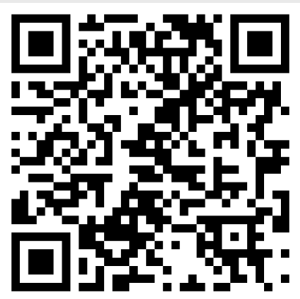
A quick survey
links.asu.edu/FF2025PreSurvey

Slide 8
Foundations

Slide 9

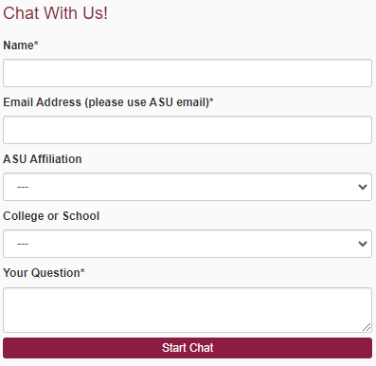
Any photo can replace this photo to support your presentation.
Ask a Librarian
Do you have questions? We have answers!
Chat and email reference services for the ASU community.
Emails are typically responded to within 24 hours.
askalibrarian.asu.edu
Ask an Archivist
askalibrarian.asu.edu/askanarchivist
Notes:
The background pattern can be swapped for another.
The vertical gold bar should remain the same height as the white text box area

Slide 10
Any photo can replace this photo to support your presentation.
Chat ID | A unique identifier for each chat generated automatically by the system
Name | Patron name.
Contact Info | Patron’s contact information, typically email address.
IP | IP address for the patron. Automatically deleted by the system 30 days after the chat.
Browser | Patron’s browser and version.
Operating System | Patron’s operating system.
User Agent | Patron’s user agent.
Referrer | Website URL through which patron accessed live chat
Widget | Springshare widget through which patron accessed live chat.
Department | Library department tasked with answering the live chat.
Answerer | Name of responding library personnel.
Timestamp | Date and time of chat initiation.
Wait Time (seconds) | Time in seconds from initiation of the chat by the patron until first response.
Duration (seconds) | Total time from initiation of chat to closure or referral of the chat.
Screensharing | Binary field for whether screensharing was used during the chat. (0: no; 1: yes)
Rating (0-4) | Optional rating provided by patron after chat. 1 (low) to 4 (high). 0 = no response
Comment | Patron provided comment during rating period.
User Field 1 | Unused field. No data within field.
User Field 2 | Patron’s self-reported role at ASU.
User Field 3 | Patron’s self-reported school at ASU.
Initial Question | Patron’s first question to initiate chat.
Transfer History | Records different users to whom the patron was transferred during the chat.
Message Count | Total number of messages between patron and library personnel.
Internal Note | Internal notes only visible to library personnel and not to patron.
Transcript | All interactions between patron and library personnel after initial question.
Tags | Optional tags added by library personnel to characterize chat. Not used in this study.
Ticket ID | Unique identifier provided to any tickets created during live chat.
Ask a Librarian data
Includes:
Patron names and emails
Patron role (faculty, student, etc.)
Patron’s school
Date and time of question
Transcript of interaction
Chat rating
Notes:
The background pattern can be swapped for another.
The vertical gold bar should remain the same height as the white text box area

Slide 11
Any photo can replace this photo to support your presentation.
What could be explored?
Patron behavior patterns
Service gaps
Information needs
Information seeking models
Notes:
The background pattern can be swapped for another.
The vertical gold bar should remain the same height as the white text box area

Slide 12
Any photo can replace this photo to support your presentation.
Ethical considerations
Privacy protection, including consent
De-identification
Interpretive responsibility
Human-centered AI principles
Notes:
The background pattern can be swapped for another.
The vertical gold bar should remain the same height as the white text box area

Slide 13
Prompting the Model

Slide 14
Prompt Engineering
A definition
Prompt engineering
The practice of designing, refining, and structuring inputs to large language models so that the model produces useful, accurate, and predictable outputs.
Keyword searching
The process of identifying and entering significant terms that represent the essential concepts of a research question in order to retrieve relevant resources.
Librarians are already prompt engineers!

Slide 15
Prompt Engineering
Examples
Zero-Shot Prompt
Tell me the sentiment of this review: “I thought the hotel room was ok”
Few-Shot Prompt
I would like to understand the sentiment of a review. Here are some examples: “The hotel’s view was fantastic” is positive; “The service was substandard” is negative; and “The buffet was unremarkable” is neutral.
Tell me the sentiment of this review: “I though the hotel room was ok”
Chain-of-Thought Prompt
What is the sentiment of this review: “We stayed here for two days and greatly enjoyed the décor in the room. It took a long time for our room service orders to arrive and food was often cold, but the manager did provide us a complementary breakfast which was fine.”
Break down your evaluation item by item and provide an overall opinion.

Slide 16
A Framework for Prompt Engineering
The CLEAR Framework
Concise: brief, clear prompts
Logical: structured prompts
Explicit: specific output requirements
Adaptive: experiment with different prompt structures and formats
Reflective: iterate through continuous evaluation
Lo, L.S. (2023). The CLEAR path: A framework for enhancing information literacy through prompt engineering. The Journal of Academic Librarianship, 49, 102720. doi: 10.1016/j.acalib.2023.102720

Slide 17
Using Generative AI to Code
Benefits and concerns
Allows non-programmers fast entry
Troubleshooting and explanations are readily available
Supports many languages
Not a substitute for in-depth coding practice or experience

Slide 18
Using Google Colab
Why this notebook?
Widely-available
Easy to share and collaborate
Can be customized to direct new programmers
Avoids placing data into an AI model

Slide 19
Analysis in Action

Slide 20
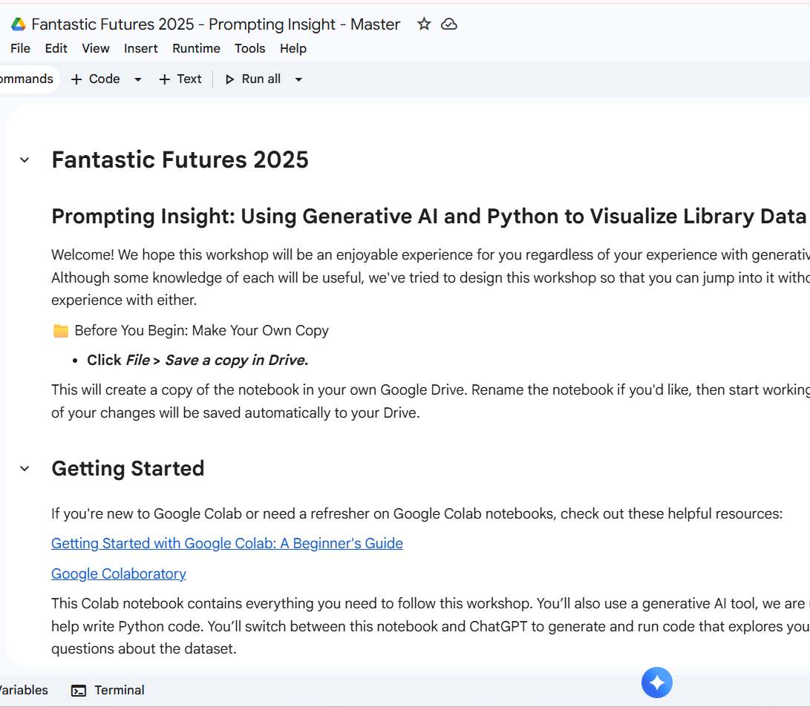
Creating a copy The structure of the notebook Generating, inserting, and running code Finding the output
Google Colab
Demonstration

Slide 21
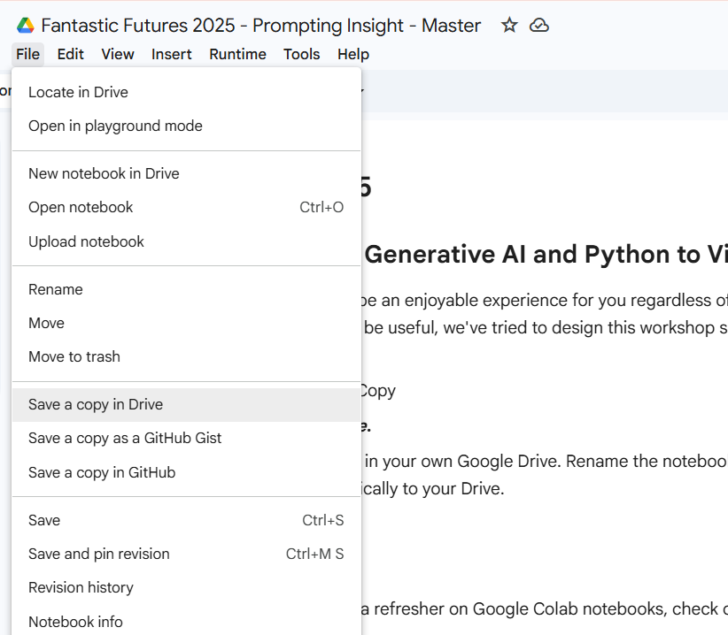
Creating a copy Loading the dataset Exploring the data Introducing the data format to the AI model Prompting the AI model for code Running the code
Group Exercise
links.asu.edu/ff2025

Slide 22
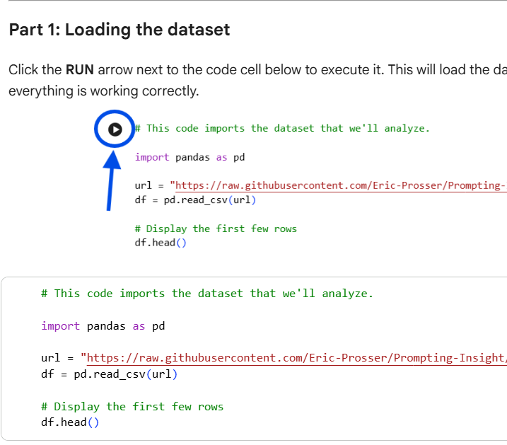
Creating a copy Loading the dataset Exploring the data Introducing the data format to the AI model Prompting the AI model for code Running the code
Group Exercise

Slide 23
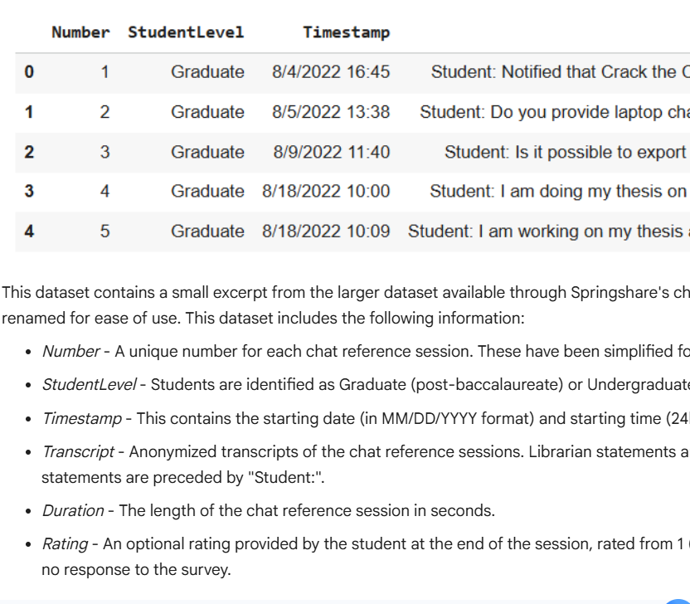
Creating a copy Loading the dataset Exploring the data Introducing the data format to the AI model Prompting the AI model for code Running the code
Group Exercise

Slide 24
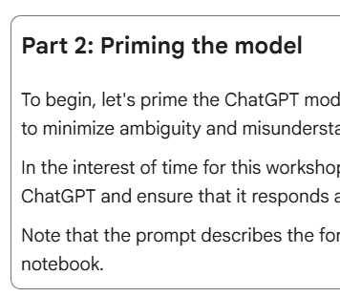
Creating a copy Loading the dataset Exploring the data Introducing the data format to the AI model Prompting the AI model for code Running the code
Group Exercise

Slide 25
Creating a copy Loading the dataset Exploring the data Introducing the data format to the AI model Prompting the AI model for code Running the code
Group Exercise

Slide 26
Creating a copy Loading the dataset Exploring the data Introducing the data format to the AI model Prompting the AI model for code Running the code
Group Exercise

Slide 27
Improving prompt quality
Where could the prompt be improved?
Concise: brief, clear prompts
Logical: structured prompts
Explicit: specific output requirements
Adaptive: experiment with different prompt structures and formats
Reflective: iterate through continuous evaluation
Lo, L.S. (2023). The CLEAR path: A framework for enhancing information literacy through prompt engineering. The Journal of Academic Librarianship, 49, 102720. doi: 10.1016/j.acalib.2023.102720

Slide 28
Performing an analysis
What would you like to know?
Text Analysis Options
Word frequency
N-grams
Keyword identification
Qualitative coding
Time-based trends
Peak usage periods
Service demand patterns
Time to respond and complete
Ratings

Slide 29
Data Visualization
Storytelling through pictures
Bar charts
Line graphs
Heatmaps

Slide 30
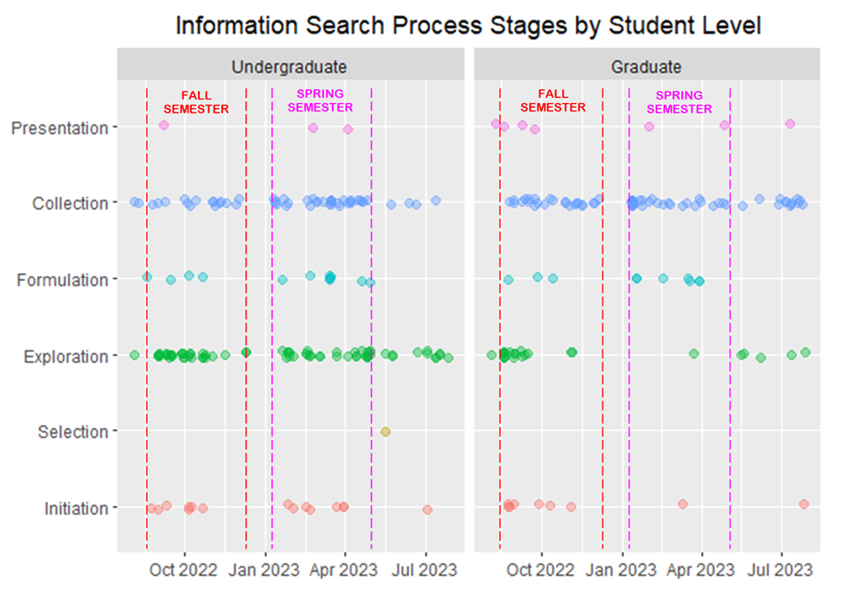
Case Study
Understanding engineering students’ behavior

Slide 31
Interpretation

Slide 32
Data Interpretation
What are we seeing?
Making meaning from data
Recognizing biases
Avoiding misinterpretation
Contextual framing

Slide 33
Functional uses
Applying insights to practice
Instruction design
Staffing optimization
Digital service development
Understanding patrons’ needs

Slide 34
Broader uses
Institutional application
Adapt methods to local datasets
Cross-department use
Strategic planning

Slide 35
Next Steps

Slide 36
Any photo can replace this photo to support your presentation.
Reflection
Where can you apply these tools or this workshop?
What datasets do you have that could use attention?
What remaining concerns do you have?
Notes:
The background pattern can be swapped for another.
The vertical gold bar should remain the same height as the white text box area

Slide 37
Open Discussion

Slide 38


Contact information
Let’s collaborate!
Eric Prosser
Jason Bronowitz
eric.prosser@asu.edu
jason.bronowitz@asu.edu

Slide 39
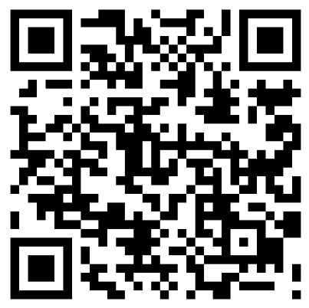
A quick survey
links.asu.edu/FF2025PostSurvey

Slide 40
Any photo can replace this photo to support your presentation.
Resources & Materials
Google Colab template
Github repository
Reading list and additional resources
Notes:
The background pattern can be swapped for another.
The vertical gold bar should remain the same height as the white text box area

